Slide 1
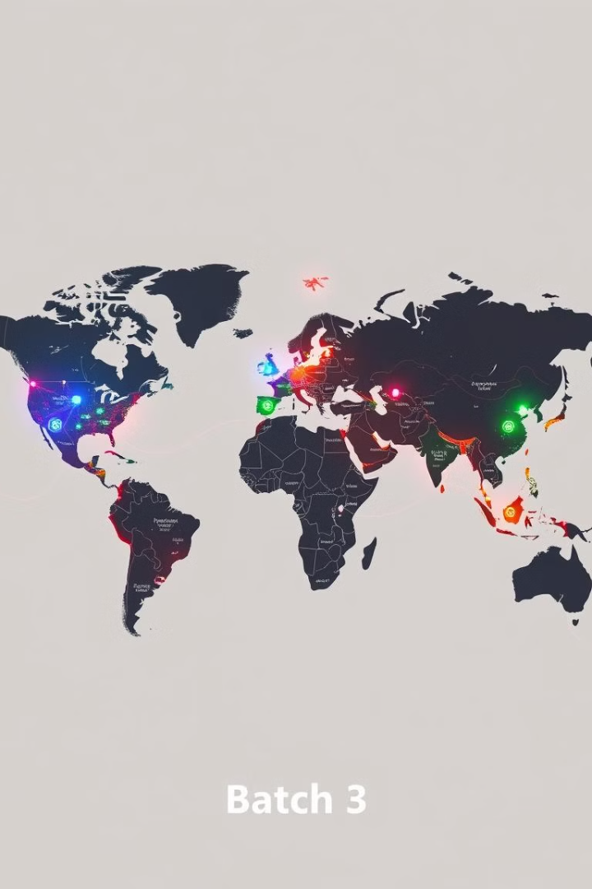
Global Market Trends Analyzer:
Batch: 3 🚀

Slide 2
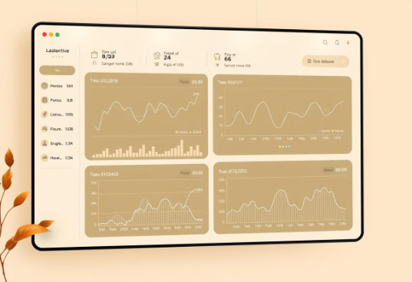
Market Trends Analysis Interface
Overview
Key Features
The Market Trends Analysis Interface is a web application designed to provide an intuitive, secure platform for analyzing financial market trends. It offers a user-friendly experience with a focus on data security and ease of use.
User Management
Registration, login, and logout functionalities with secure password hashing.
Emphasis on data security and usability.
Financial Data Insights
Integration with the Alpha Vantage API for fetching real-time market data.
Search by ticker symbols to retrieve and analyze stock trends.
Interactive Visualization
Charts and graphs to visualize market trends dynamically.
Real-time insights to assist users in financial decision-making.
Technology Stack
Framework
Database
Data Processing
Streamlit
SQLite
Pandas

Slide 3
Milestone 1
Module 1: User Authentication and Registration
Module 2: Market Data Management
Implemented Features:
Functionalities Implemented:
Database schema for market data storage.
User registration and login.
Integrated public APIs for real-time and historical data.
Email verification and password reset.
Profile display with user picture post-login.
Admin dashboard for CRUD operations and graphical market trends.
Security Measures:
Password hashing using SHA256.
Session-based authentication.

Slide 4
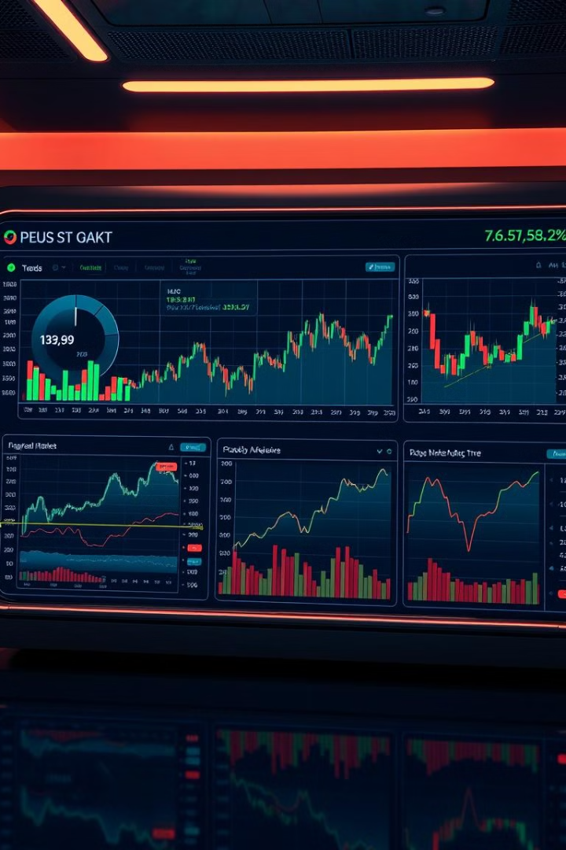
Milestone 2
Module 3: Market Trends Analysis
Functionalities Implemented:
Date range selection and specific market indicators.
Machine learning models for trend prediction.
Advanced analytics for insights on market movements.
Technologies Used:
Backend: SQLite, APIs.
Frontend: Streamlit.

Slide 5
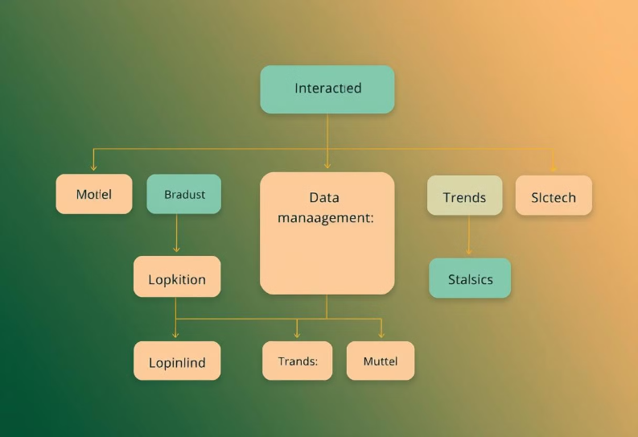
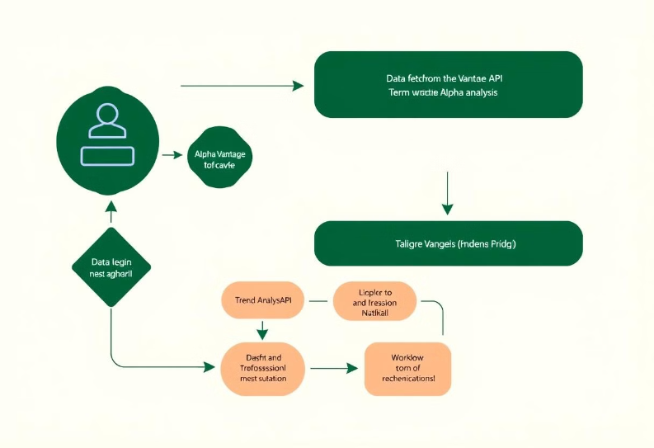
Class Diagram
Flowchart

Slide 6
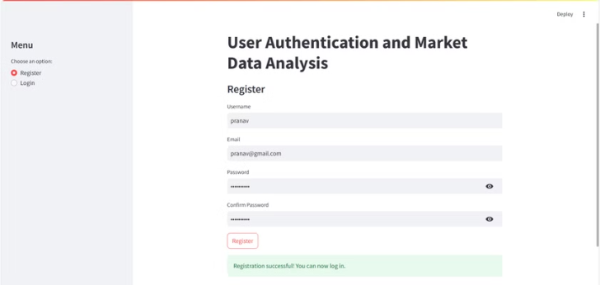
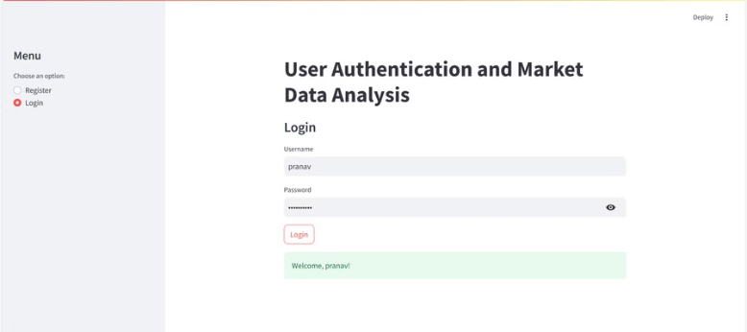
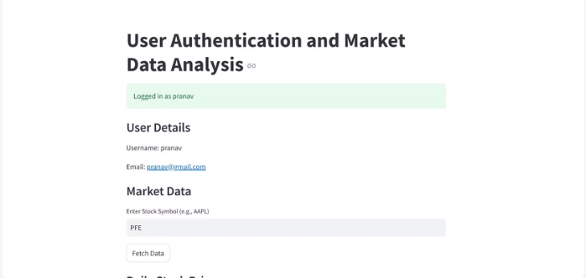
User Authentication & Registration Page

Slide 7
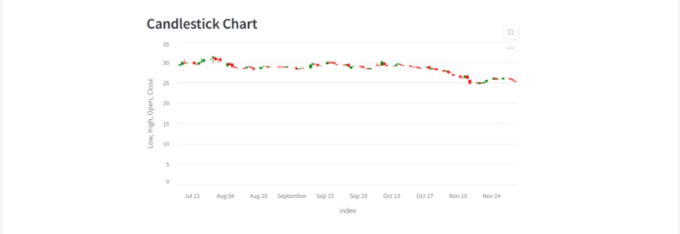
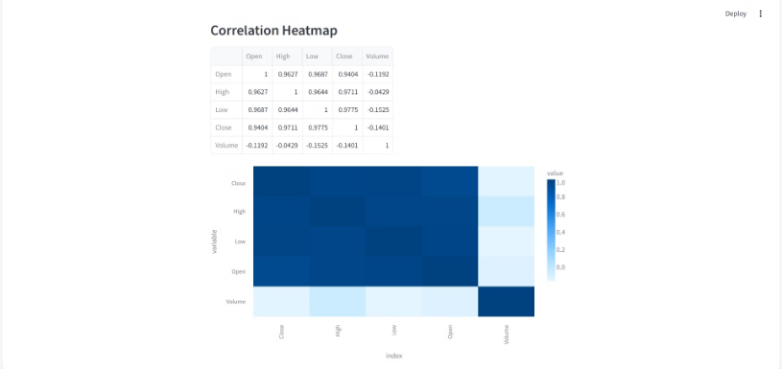
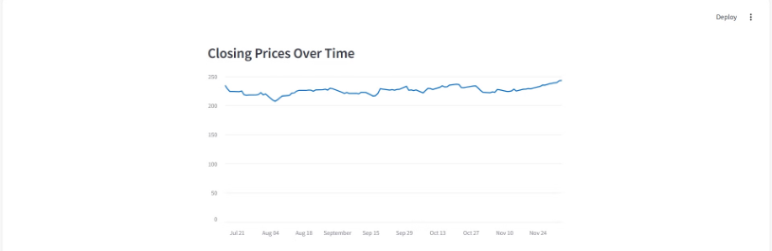
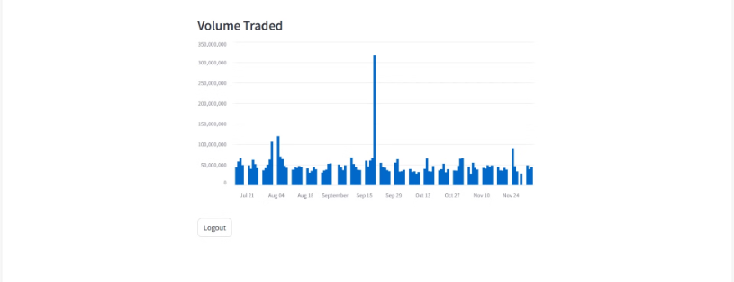
Market Trends Interface:

Slide 8
Charts in Market Trends Analysis Interface
Candlestick Chart
Purpose: Visualizes stock price movements (open, high, low, close) to identify trends and patterns crucial for technical analysis.
Relevance: Essential for traders to pinpoint potential buy/sell signals and key price levels.
Correlation Heatmap
Purpose: Shows relationships between different stocks or indicators through a color-coded matrix.
Relevance: Helps identify diversified investment opportunities and spot positively correlated sectors.
Closing Prices Over Time
Purpose: Tracks the daily closing prices of a stock over a customizable period.
Relevance: Facilitates performance monitoring, trend identification, and pattern recognition for informed decision-making.
Trading Volume
Purpose: Displays the volume of shares traded, indicating market activity and liquidity.
Relevance: Provides insights into potential market momentum shifts and helps detect unusual trading patterns.

Slide 9
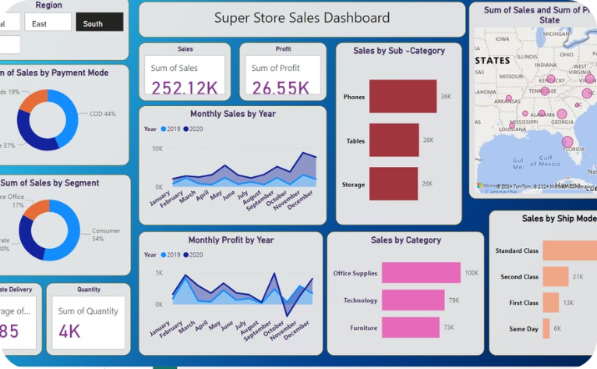
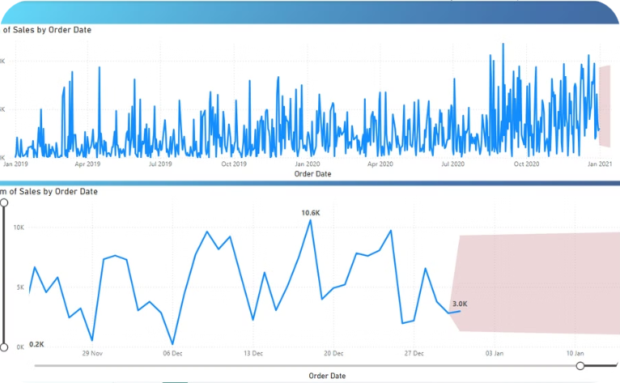
Milestone 3
Data Visualization with Microsoft Power BI: Unlocking Insights through Interactive Dashboards
Power BI Dashboard
Sales Forecasting
Developed a Power BI dashboard for the Superstore dataset of the United States (2019-2020).
Conducted sales forecasting using time series analysis to derive actionable insights for the business.

Slide 10
Superstore Sales Dashboard and Insights
Objective: To leverage data analysis, specifically time series analysis, to provide valuable business insights and accurate sales forecasting, contributing to overall success.
252.12K
26.55K
Total Sales
Total Profit
Generated through an interactive Power BI dashboard built using 2019-2020 Superstore sales data.
Derived from the comprehensive sales data within the dashboard, and filtered by region, category, and payment modes.
3.85
4K
Avg. Delivery Days
Total Quantity
Reflecting the efficiency of delivery processes as showcased in the dashboard.
The total number of units sold. Data available within the interactive Power BI dashboard.

Slide 11
Insights Provided
Sales by Region
Payment Modes
Segment Performance
Southern region achieved the highest sales.
Cash on Delivery (COD): 44%
Consumer segment contributed 54% of total sales.
Online Payments: 37%
Card Payments: 19%
Product Categories
Shipping Mode
Technology led sales (100K), followed by Office Supplies and Furniture.
Standard Class preferred for 48% of shipments.

Slide 12
Trends and Time Series Analysis
Key Trends
1
Monthly sales and profit trends show peak sales in Q4 (October-December).
Time series analysis forecasted the next 15 days' sales (~3K).
2
Recommendations
Increase marketing efforts in high-performing regions (e.g., South).
Focus promotions on Technology products during Q4.
Optimize inventory for peak shipping modes and periods.
Tools Used:
Power BI: For dashboard design and visualization.
Time Series Analysis: For forecasting trends based on historical data.

Slide 13
Module 4 – Search and Comparative Analysis Service
Database Schema
Backend Functionality
Predictive Insights
Designed to store and organize industry-specific and company-specific data efficiently. Optimized for scalability to handle large datasets.
Enables secure retrieval of sector-wise market reports. Supports dynamic querying for comparative analysis across industries.
Integrated ML models to predict market trends and performance metrics. Insights visualized for decision-making support.
Frontend with Streamlit
Testing and Validation
User-friendly interface for data viewing and comparison. Interactive filters and charts to explore datasets intuitively.
Implemented test cases using pytest for code reliability and coverage. Form validations ensure data consistency and prevent errors.

Slide 14
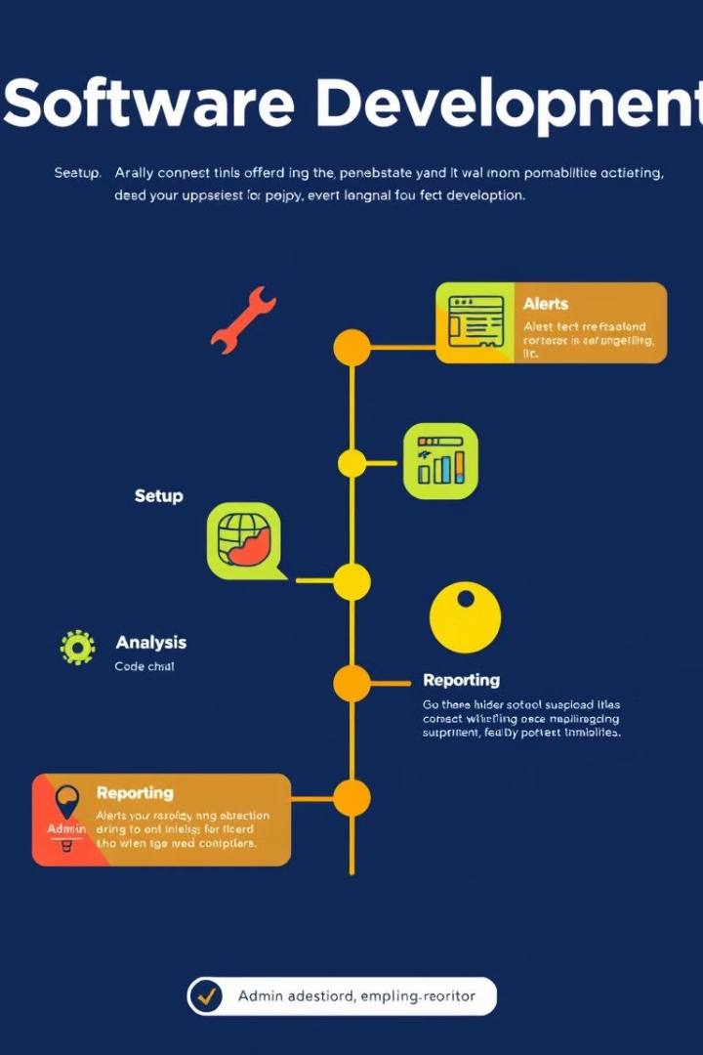
Milestone 4
Initial Setup and Architecture Design
1
2
Core Features Implementation
Search and Comparative Analysis Service
3
4
Custom Report Generation and Export
Alert and Notification System
5
6
Admin Dashboard

Slide 15
Market Trends Analysis Functionality
Overview Analyze real-time and historical stock data interactively across multiple industries with insightful visualizations.
Key Features
Python Code Use for getting real-time Stock prices:
Company Selection: Choose companies by category (e.g., Tech, Financials) with easy stock code access (e.g., AAPL).
import yfinance as yf
stock_data = yf.download(selected_code, start=start_date, end=end_date)
Date Range: Flexible start and end date selection, auto-adjusting for upcoming market days.
Data Source: Use yfinance for real-time Open, High, Low, Close, and Volume data without API keys.
Interactive Table: Display tabular data with highlighted maximum Close prices for quick insights.

Slide 16
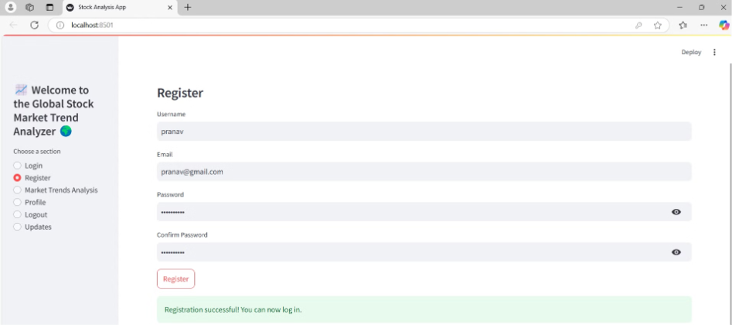
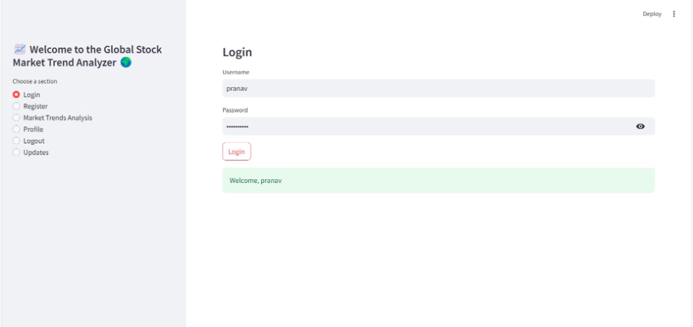
Secure User Gateway: Registration & Login Success!

Slide 17
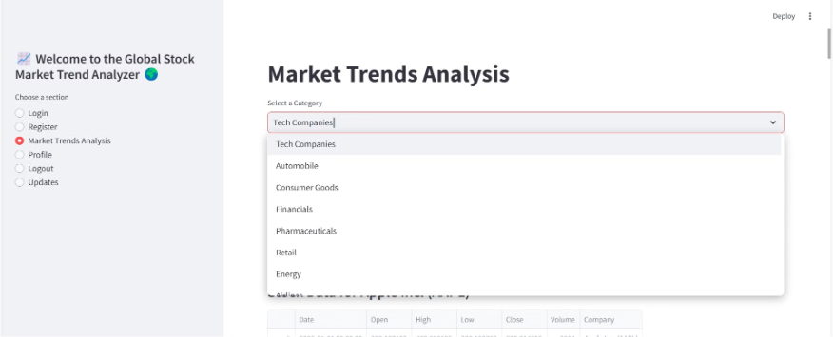
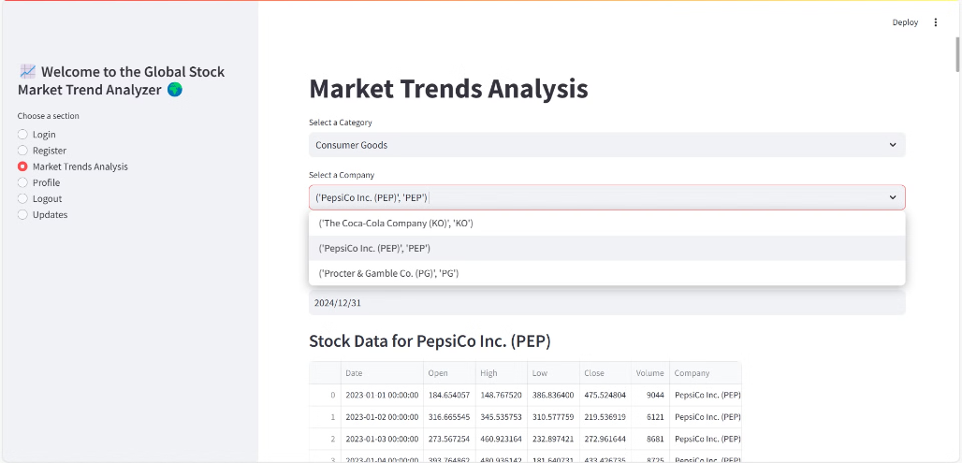
Stock Data Retrieval: Category & Company-Wise

Slide 18
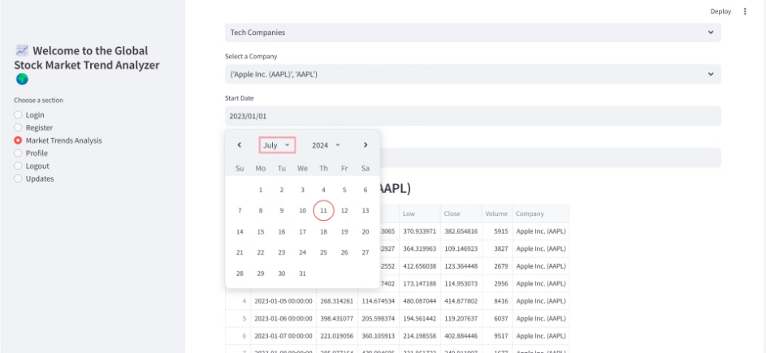
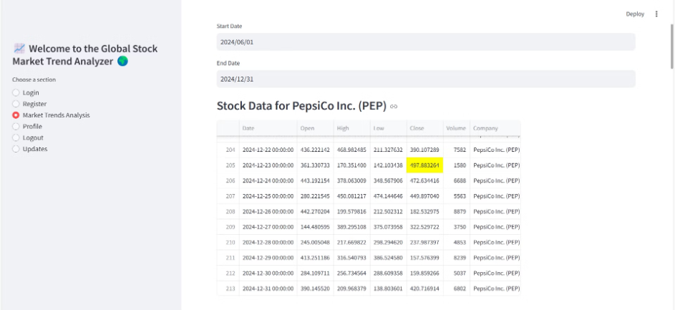
Stock Data Visualization

Slide 19
Visualization and Insights
Chart Types & Visualizations
Analytical Advantages
Area Chart: Visualizes overall stock price trends over time, highlighting growth or decline.
Multi-Company Comparisons: Analyze trends across multiple companies and categories easily.
Line Chart: Tracks stock trading volume trends to identify market interest and momentum.
Customizable Date Ranges: Explore data with flexible start and end date selection for in-depth analysis.
Doughnut Chart: Summarizes market activity by showing volume distribution (High vs. Low).
Key Performance Indicators (KPIs): Direct access to opening price, closing price, and total volume for immediate insights.
Gauge Chart: Provides a quick assessment of stock performance on a visually intuitive scale.
Scalable Data Source (yfinance): Access live market data without API keys for real-time analysis.
Waterfall Chart: Demonstrates stock movement (gains/losses) clearly over the first 30 days of data.
Candlestick Chart: Provides a detailed representation of daily price fluctuations (Open, High, Low, Close).

Slide 20
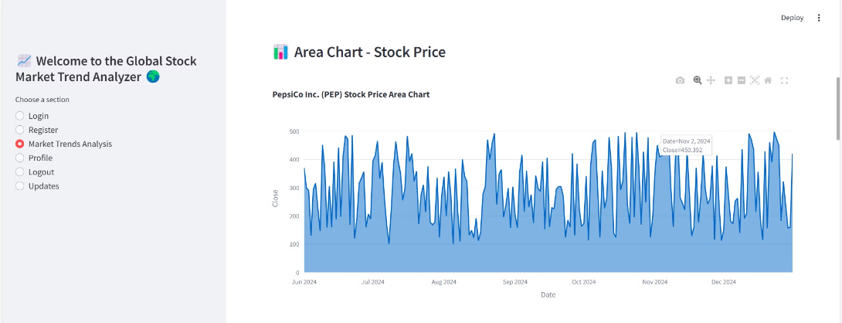
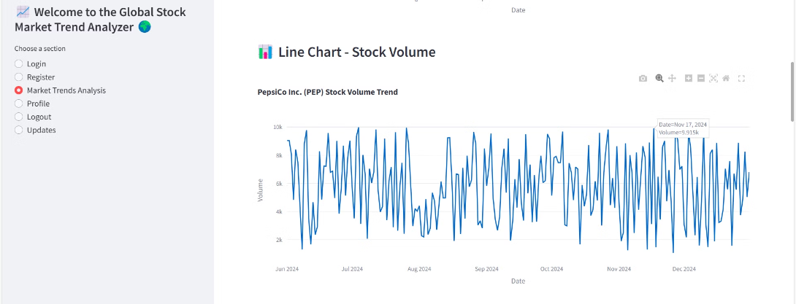
Stock Price Trends: Area & Line Charts

Slide 21
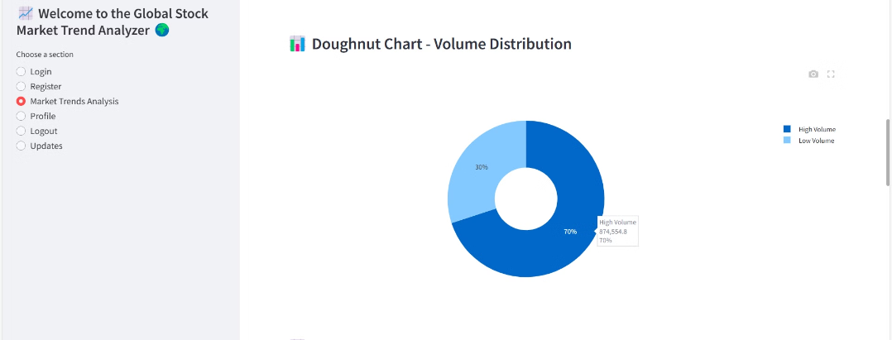
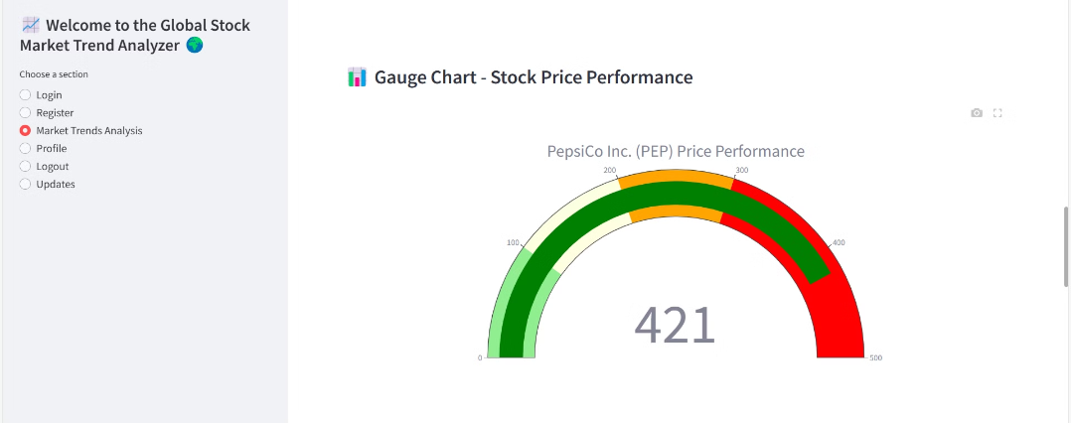
Stock Performance at a Glance: Doughnut & Gauge Charts

Slide 22
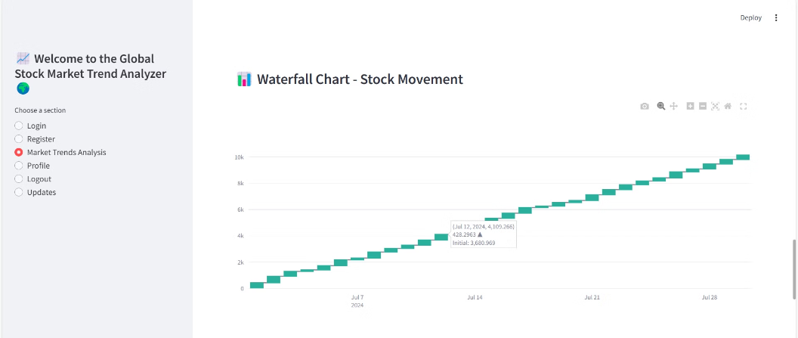
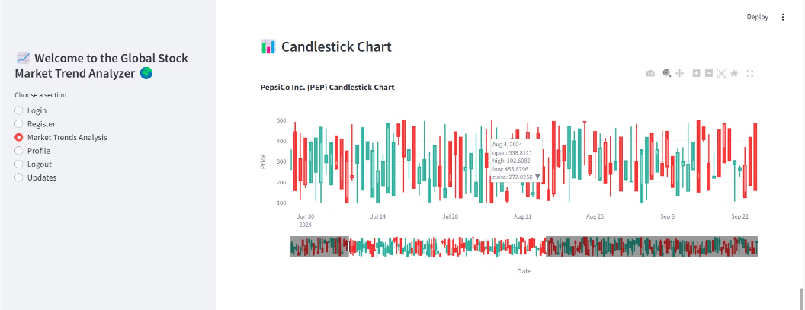
Stock Market Dynamics: A Visual Deep Dive

Slide 23
Module 5 – Custom Report Generation and Export
Database Schema 💾
Report Customization 🎨
Advanced Visualizations 📊
Designed for secure storage of user-generated reports. Implements encryption for sensitive report data.
Users can select metrics and visualizations for personalized reports. Supports exporting reports in formats like PDF and CSV.
Utilized visualization libraries (e.g., Matplotlib, Plotly) for professional-grade visuals. Dashboard displays historical, current, and predictive data.
Frontend with Streamlit ✨
Testing and Validation 🧪
Streamlined UI for seamless customization and export operations. Form validations and interactive elements ensure usability.
Comprehensive test cases for backend logic and frontend functionalities. High-level code coverage achieved with pytest.

Slide 24
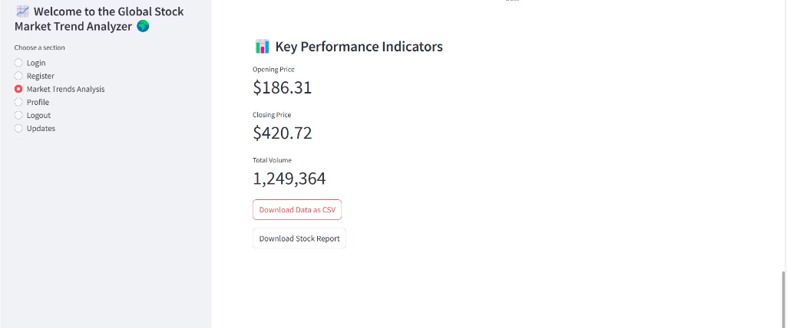
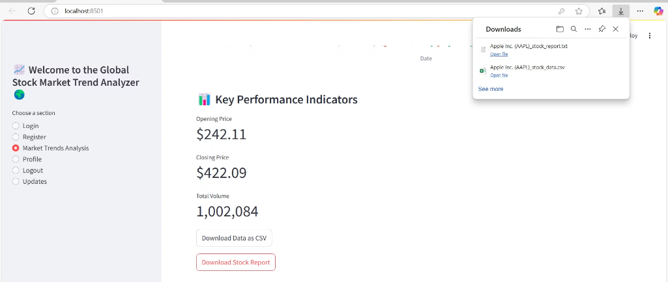
Download Your Custom Reports: CSV, PDF, and More!

Slide 25
Module 6 – Alert and Notification System
Notification Integration
Intelligent Alerts
Configured email and push notifications for real-time updates. Notifications include significant market changes and emerging trends.
ML models predict patterns and generate user-defined alerts. Alerts based on thresholds and preferences enhance user experience.
Backend and Frontend
Validation and Testing
Secure backend to track and manage user-defined alerts. Interactive UI with Streamlit to customize and manage alerts.
Validations to prevent duplicate email/mobile entries. Test cases ensure accurate notifications and robust system handling.

Slide 26
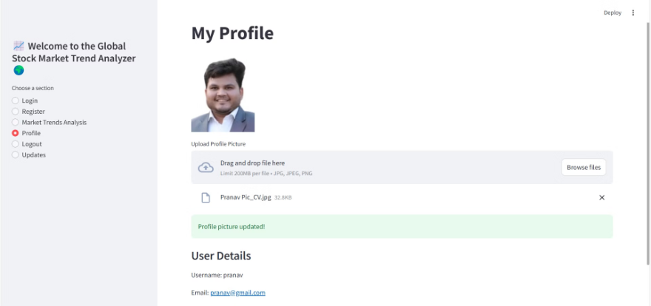
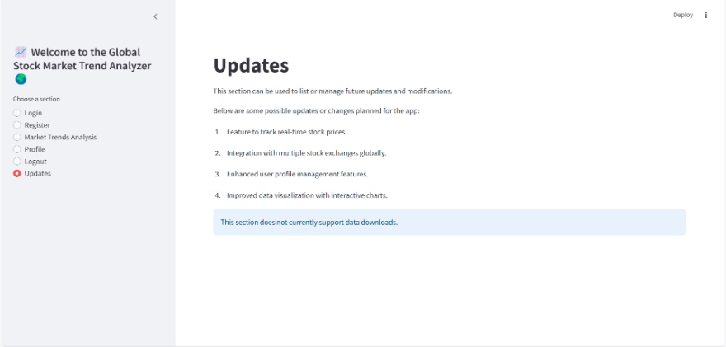
Personalize Your Profile: Picture & Updates
Upload a profile picture for easy identification and manage your app settings through our intuitive update section.

Slide 27
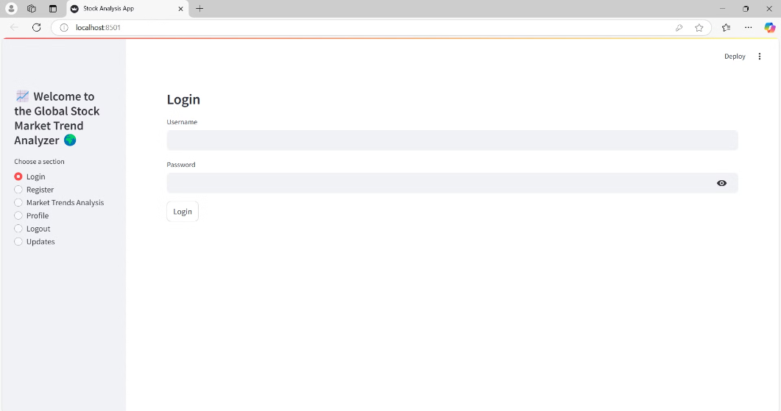
Module 7 – Admin Dashboard
Admin Controls
System Overview
Frontend and Testing
User management capabilities: add, edit, and delete users.
Dashboard provides a comprehensive view of market data and system activity.
UI designed with Streamlit for ease of use and accessibility.
Manage data sources, access levels, and system settings.
Real-time updates and logs for admin review.
Test cases for all admin features to ensure reliability and security.

Slide 28







Testing Strategy Design Approach
Comprehensive Testing
UI and UX Principles
Pytest Coverage
Form Validations
Intuitive Navigation
Clear Visual Hierarchy
Backend and frontend functionalities extensively tested. Achieved high reliability with detailed test cases.
Ensured proper input handling and error prevention.
Focus on usability.
Seamless interaction.
Streamlit Integration
Interactive Frontend
Cross-Module Compatibility
Code Quality
Responsive development.
Uniformity.
Followed industry standards for maintainability and readability.
Power BI Dashboard
Key Metrics Visualization
Strategic Decision-Making
Using Power BI.
Dynamic insights.

Slide 29
Conclusion: Achievements & Future Enhancements
Achievements:
Enhanced Security: Implemented hashed password authentication.
Market Data Integration: Real-time stock data via yfinance (no API key required).
Interactive Visualizations: Area, Line, Doughnut, Gauge, Waterfall, and Candlestick charts.
Actionable KPIs: Displayed Opening Price, Closing Price, and Total Volume.
Custom Reports: Personalized reports with export options (PDF, CSV).
Future Enhancements:
Multi-Factor Authentication: Enhance security.
Advanced Analytics: Add predictive modeling and sentiment analysis.
Expanded Data Sources: Integrate more APIs for diverse financial data.
Tools Used:
Streamlit, SQLite, Pandas, yfinance, Plotly, Matplotlib.

Slide 30
Team Contributions 🎉
Milestone 1: Shreyas S.K 🧑‍💻
Milestone 2: Yarrapothu Yashwitha 📊
Milestone 3: Prabhu Jampani 🧪
User authentication, database design for market data, API integration, and admin dashboard development.
Market Trends Analysis Interface, live data integration, ML models for predictions, and Streamlit frontend design.
Search and Comparative Analysis Service, industry data schema, ML insights, and testing with pytest.
Milestone 4 & UI Design: Pranav Jambhale (Team Leader) 🎨
Power BI Dashboard: 🤝
Collaborative effort by all team members showcasing key insights and trends.
Custom Report Generation, Alerts and Admin Dashboard, UI design, and advanced visualizations.

Slide 31

Team Members:
- Pranav Jambhale (Team Leader) 👨‍💻
- Shreyas SK 📊
- Yarrapothu Yashwitha 🌍
- Prabhu Jampani 💡

